Slide 1

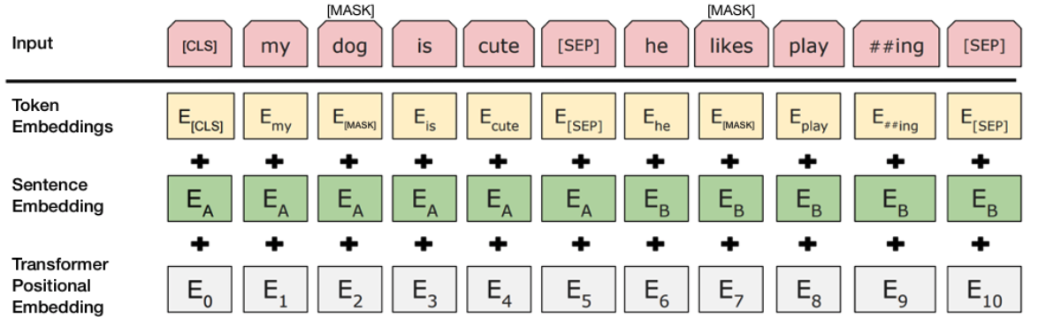
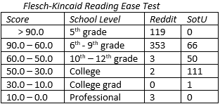
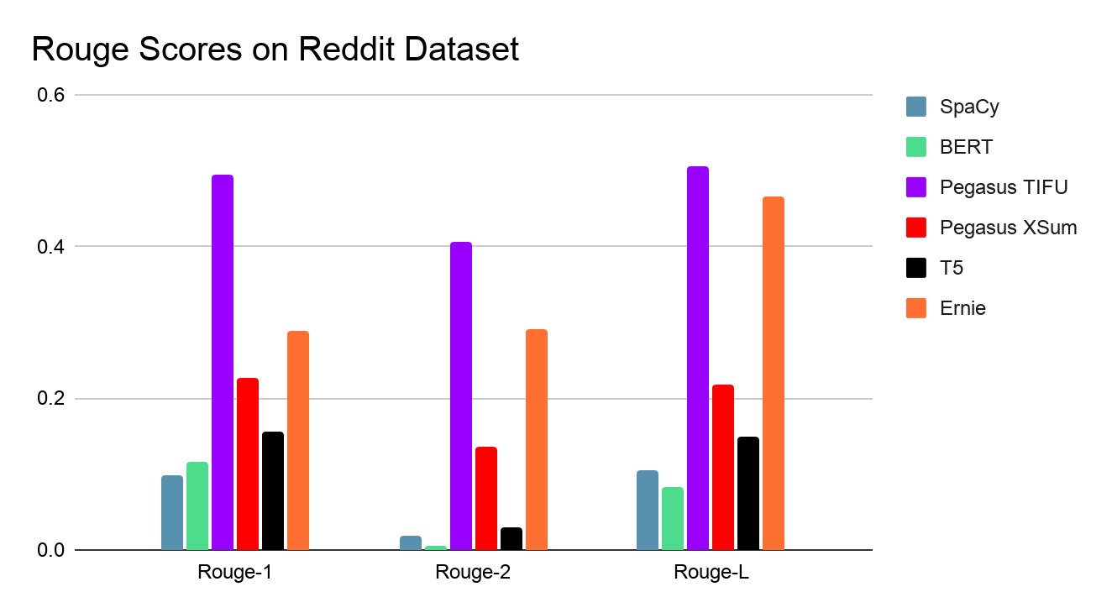

Text Summarization: Making Sense of the State of the Art
Varun Joshi, Rick Gao, Fawaz Khurram, Adithya Viswanathan, Dylan Trang, Brian Nguyen
Problem
Approach
Experimental Results
Analysis
Abstract: Researchers are always on the bleeding edge of what is possible in Text Summarization, but taking a step back and doing analysis on current state-of-the-art models is vital. The data we gathered in this process shows how one dataset performs in 5 different models. Moreover, we explored these different type of models on a completely different corpus in terms of style and rhetoric. Therefore, we present a thorough exploration of various extractive and abstractive text summarization models in order to test their effectiveness and acknowledge their limitations.
Extractive: producing a verbatim compilation of important sections of the text
Abstractive: paraphrasing to create a summary with vocabulary not used in the corpus
Extractive Models
SpaCy - This traditional but simple approach is known as TF-IDF (Term Frequency-Inverse Data Frequency), a method in which the most heavily and frequently used words, phrases and sentences are compiled. This is done through the calculation of normalized weights and sentence sorting. Overall, this approach is good when it comes to extracting keywords, thus making it a good starting point for extractive summarization.
BERT - Also known as Bidirectional Encoder Representations from Transformers, BERT is a model for pre-training language representations. It utilizes bidirectional contextual representations, meaning each word gets its context from its left and right words. The BERT architecture consists of an encoder and summarization classifier, who work together to generate and classify the language representations.
Specifically, the encoder learns about the interactions between words, while the summarization classifier learns about the interactions between sentences. The BERT model uses about 120.5 million parameters.
Abstractive Models
PEGASUS - the PEGASUS model uses sequence to sequence modeling in order to create abstractive summaries. Sequence to sequence modelling is a modelling practice in which a model is trained through a neural network to map input sequences to output sequences. However, PEGASUS uses a transformer encoder-decoder model because they work better with modeling the dependencies in longer sequences that are common in summaries. The PEGASUS model is trained by giving it a document with missing sentences. It then has the task of filling out these missing sentences. The effectiveness of PEGASUS also relates to the datasets it was trained on. Through this, it is able to create abstractive summaries. The model uses 568 million parameters
Text-To-Text Transfer Transformer (T5) - Google’s transfer learning model, which involves pretraining a transformer to perform general NLP tasks while providing foundation for further training in specific NLP tasks. The base model is competent at most NLP tasks as a starting point, but has many shortcomings. The true model shines when it is trained for a specific task, after which it tops many other model’s GLUE scores. In this study we used the T5-base, which uses 220 million parameters
ERNIE - Baidu’s state of the art continuous learning model, uses multitask learning to integrate syntactical and semantic data information from data enhancing its existing knowledge base. Any task can be added at any time and it uses the data to incrementally accumulate its knowledge to apply for future tasks. The Ernie model with 114 million parameters was used for this task.
Extractive Models
SpaCy- The speech summaries came out concise and compressed but there was no context around what the summary was talking about. For example, one of the summaries started out with “This, however, shall if possible be avoided”; it did not extract the important part, WHAT should be avoided? The SpaCy Extractive Model fails to capture the context around the important parts. On the other hand, with the Reddit dataset, there were golden summaries (TLDRs). This model performed most than most of the other models for two reasons. First, it takes an extractive approach, which doesn’t synthesize new information. Secondly, the model was poor in terms of its recognition of proper sentence structure. For example, in a post about an incident with beer and bugs, the summary simply was "the walls, and the ground did not help matters much, either."
BERT - BERT’s performance on the speech and Reddit datasets were subpar, evident from the low ROUGE scores. The model that was used to generate the summaries was trained on news article datasets that rely on putting information at the front of the text. Speeches and Reddit posts tend to put the most important information in the body, therefore BERT did not perform well. The ROUGE scores were all less than .11, indicating that the model did not extract the most of the significant texts found in the tldr.
Abstractive Models
PEGASUS - Using the PEGASUS model, we experimented on two of the pretrained models. The first model was pre trained on reddit_tifu (similar to our dataset), and the ROUGE score average was about .4. In some cases the ROUGE score was as low as .21 and in other cases it was as high as .92. The next pretrained model used was trained on xsum or extreme summarization, which is a dataset that contains one sentence summaries of news articles. This was thought to be a good format for the reddit summaries as they are also one sentence. This resulted in average ROUGE scores to be .26. It is interesting to note that some summaries created had a ROUGE score of .9 and above, but the majority were very low ranging from .03 to .25. The summary results were fluent, but not as specific as the tldr or human summaries that could be written after reading the dataset.
Text-To-Text Transfer Transformer (T5) - The T5’s general training on the C4 and CNN/Dailymail dataset resulted in an average score of .15. This low score can be attributed to the fact that the content of the summaries were accurate, but most of them were attributed to CNN anchors, as the model was biased to attribute styles of speech to them.
ERNIE - Ernie is trained on multiple different datasets and besides that in my case has been pretrained on a reddit channel using paddlepaddle. The rouge scores are also in a higher range between 0.25 to 0.45. A reason for this could be as this is the ernie-tiny model that uses 1/4th of the transformers than the state of the art ernie-large model. Overall, the summaries were well generated but fell short of the human TLDR’s.
Insights:
• News articles tend to place the most relevant information at the beginning or end of the text, and models trained on news articles mainly extract information from each end of the text. BERT, a model trained on CNN/DailyMail, performed poorly on the speeches and reddit datasets, where significant information is more scattered throughout the text.
• With the Reddit dataset, important information for summarization was often located in the title, leaving it out of the main text.
• Models trained on modern English corpora struggled with summarization on older English texts such as speeches from 1790 to the 1850’s.
• Abstractive models generally performed better on summarizing Reddit posts because the reference summaries are also generally abstractive.
• With the Reddit dataset, the varying amounts of writing styles from different users resulted in variable summarization results generated from the model rather than a uniform style.
Limitations:
• To meet limited computational resources, we ran smaller and less powerful versions of the original pre-trained models.
• We only performed summarization analysis for corpora in English and did not consider other languages. The ERNIE Text Summarization Model is trained and performs better on Chinese texts, but we did not consider that here.
• There are no available reference summaries for the State of the Union speeches, meaning we could not reliably analyze the effectiveness of our models.
Creating summaries for the speeches manually was difficult due to the length and amount of speeches there were.
• Many of the models were pre trained on certain corpus that had different language styles than our datasets such as being trained on CNN Dailymail, but creating summaries for reddit posts.
• Lack of hardware resources to efficiently run some models on large texts such as the State of the Union speeches.
• T5 could not be used properly due to time constraints restricting training
Data
Reddit TIFU (Jan 2013 - March 2018)
"my boss had a stroke. he was hospitalized today. while a coworker was explaining his status i had my ear buds in and was laughing hysterically like a hyena at adviceanimals.”
Tldr: caught laughing during bad news
Figure 1. Example of Reddit TIFU Post with TLDR
State of the Union Speeches (1790 - 2019)
That's the America I know. That's the country we love. Clear-eyed. Big-hearted. Optimistic that unarmed truth and unconditional love will have the final word. That's what makes me so hopeful about our future. Because of you. I believe in you. That's why I stand here confident that
the State of our Union is strong. Thank you, God bless you, and God bless the United States of America.
Figure 2. Example of State of the Union Speech Excerpt
Figure 5. BERT Architecture [3]
Conclusion
Researchers in Natural Language Processing are constantly refining their tools and models to becoming the state of the art, but there is limited understanding on why some models perform better than others. With this observation, we provided a better understanding of how each model performs on comparatively different corpora of texts and analyzed the limitations that contributes to the resulting performance. We observe that abstractive models generally performed better than extractive models on datasets that are large and varying in writing styles. Furthermore, we note that models performed better on datasets that more closely resemble the datasets they were trained on.
References
[1]D. Huang et al., "What Have We Achieved on Text Summarization?", Aclweb.org, 2020. [Online]. Available: https://www.aclweb.org/anthology/2020.emnlp-main.33.pdf. [Accessed: 17- Nov- 2020].
[2]Y. Liu and M. Lapata, "Text Summarization with Pre Trained Encoders", Arxiv.org, 2019. [Online]. Available: https://arxiv.org/pdf/1908.08345.pdf. [Accessed: 17- Nov- 2020].
[3]C. Tran, "Extractive Summarization with BERT", Chris Tran, 2020. [Online]. Available: https://chriskhanhtran.github.io/posts/extractive-summarization-with-bert/. [Accessed: 17- Nov- 2020].
[4]“Application of Pre-training Models in Named Entity Recognition.” [Online]. Available: https://arxiv.org/pdf/2002.08902.pdf. [Accessed: 17-Nov-2020].
[5]Arxiv.org. 2020. [online] Available at: <https://arxiv.org/pdf/1904.09223.pdf> [Accessed 17 November 2020]
Figures 3 and 4. Flesch-Kincaid Reading Ease Test results for Reddit and State of the Union datasets

Slide 2
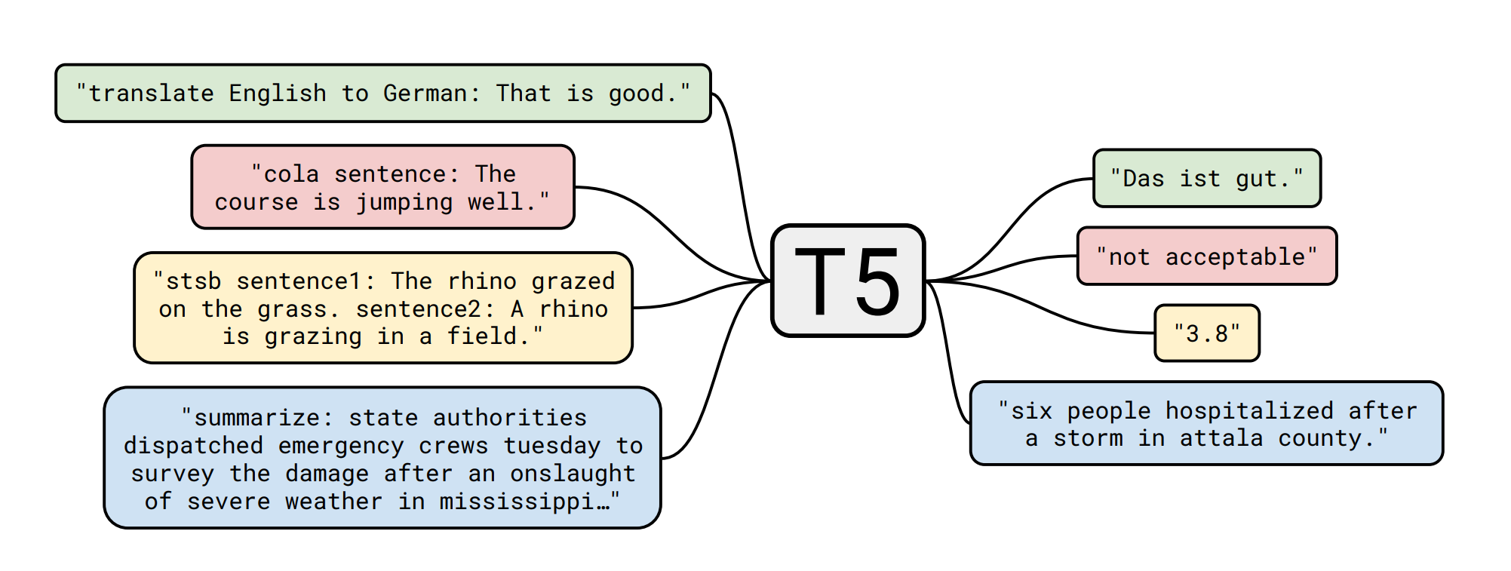
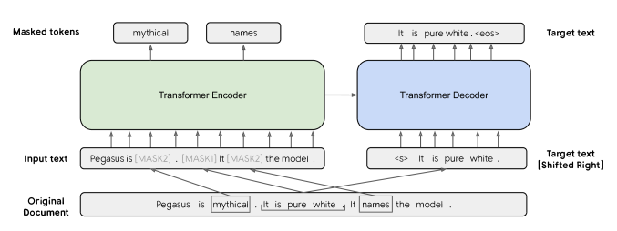
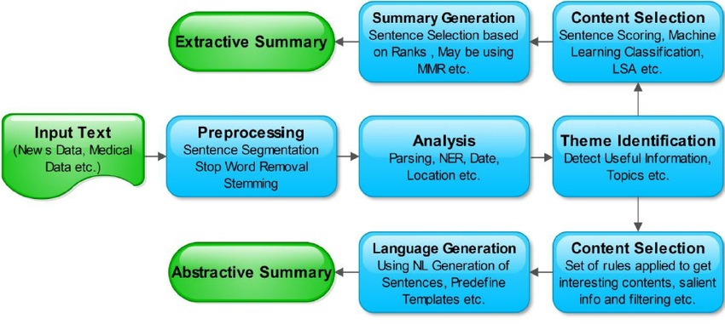
Backburner
[1] Domain Independent Framework for Automatic Text Summarization - Scientific Figure on ResearchGate. Available from: https://www.researchgate.net/figure/Generic-Automatic-Text-Summarization-Process_fig1_277935873 [accessed 16 Nov, 2020]

